Slide 1



DELUR SERVICES

Slide 2


BACKGROUND
Delur Services is a customer-centric company that provides a wide range of products to customers across different states. Our dedicated team of Customer Support Agents, ensures that every customer interaction is handled with utmost care and efficiency. We take pride in delivering products on time and ensuring a seamless delivery performance to meet our customers' expectations.
Delur Services is committed to maintaining a high level of customer satisfaction. We carefully track customer feedback, and our focus on continuous improvement allows us to enhance our services based on valuable insights received from customers, enabling us to provide an exceptional customer experience.

Slide 3
BUSINESS GOAL
Delur Services wants to obtain an overview of their data. They noticed discrepancies in their return rate and are looking towards:
Achieving a target return rate of 5% for the coming year.
To better understand their data
Getting valuable insights and recommendations to help them reach their targets

Slide 4
DATA DICTIONARY
Date: Date when the transaction occurred
Customer Acquisition Type: Customer was acquired through what marketing channel.
Customer support agent: Who handled the interaction with the customer.
Return: An indicator representing whether the customer returned the product after purchase.
Customer Satisfaction: Level of satisfaction expressed by the customer after the interaction or purchase.
Delivery Performance: Efficiency and timeliness of the delivery process.

Slide 5
INSIGHTS GATHERED
Total quantity ordered in the year 2018 and 2019 are 10,643 and 9,646 respectively but the total orders in those years are 1,959 and 1,757 respectively.
Based on return rates, we recorded a higher percentage of returns in 2019 than in 2018.
Return by state- Georgia had the highest number of return by rate.
Ad had the highest number of return in 2018.
We can see an up and down movement in trend of returns from January 2018 to December 2019.

Slide 6
SNAPSHOT OF DASHBOARD
Let me walk you through my dashboard and the analysis of my data.
ENJOY

Slide 7
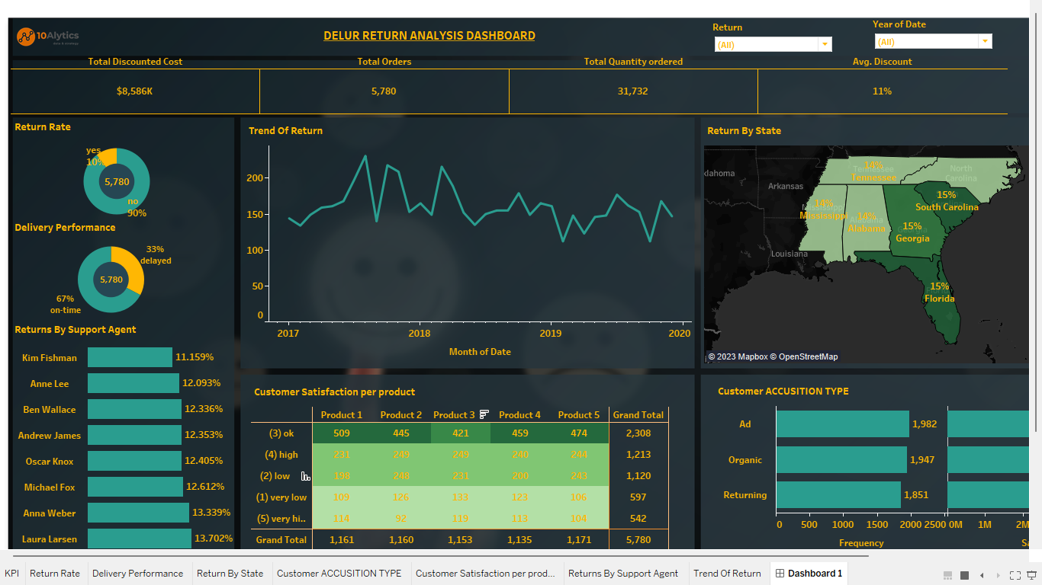

Slide 8
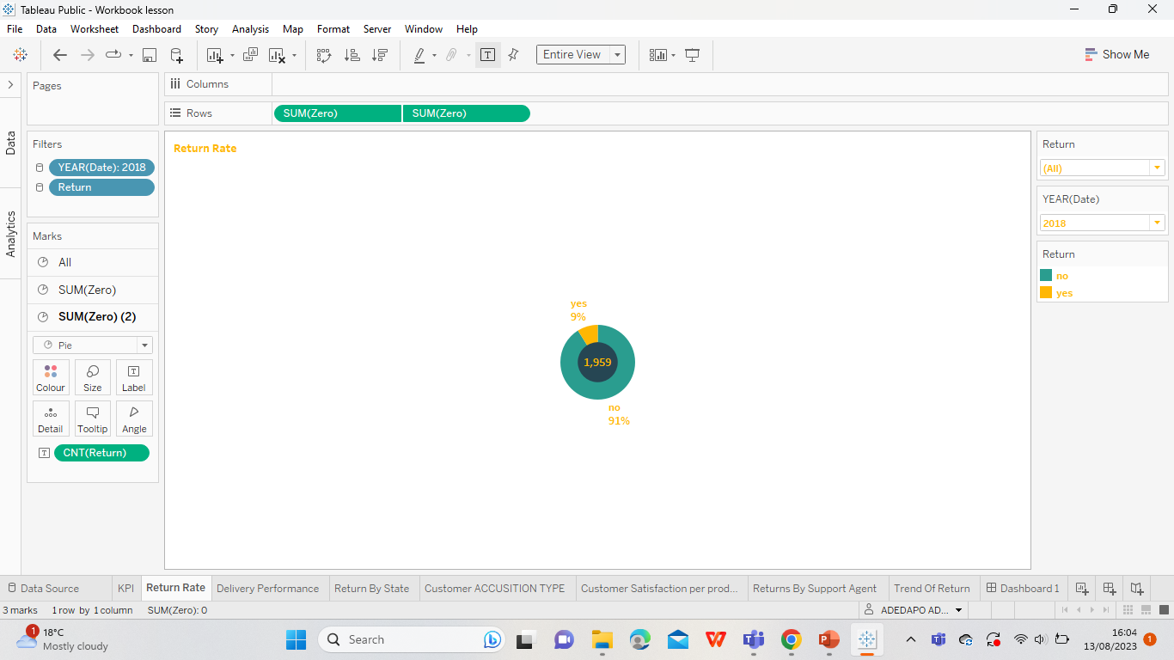

ANALYSIS OF THE DATA (2018-2019)- Return Rate We recorded a higher percentage of returns in 2019 than in 2018. As a result, this must be checked as It rose from 9% to 11%, this shows something is wrong.

Slide 9
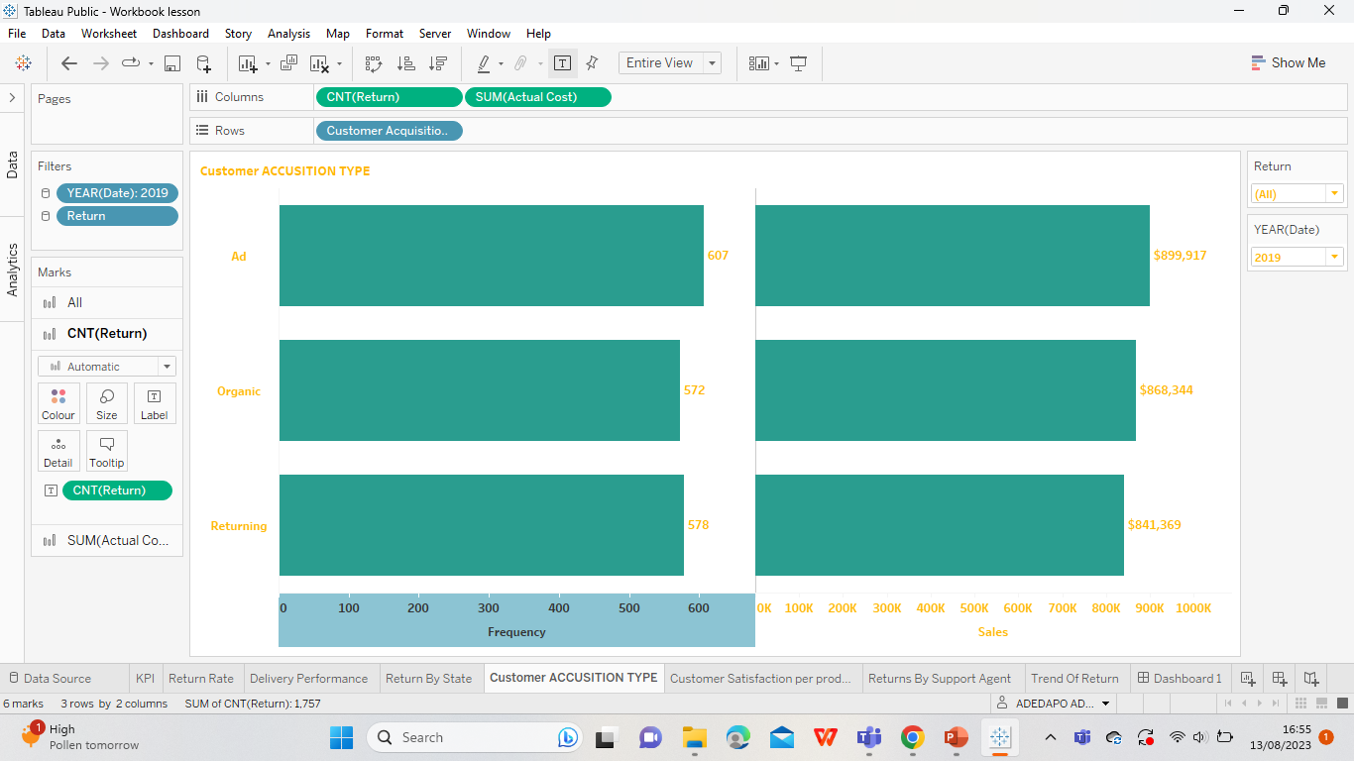
ANALYSIS OF THE DATA-Customer Acquisition type
Ad had the highest number of frequency with returns of goods in 2018 and 2019.

Slide 10
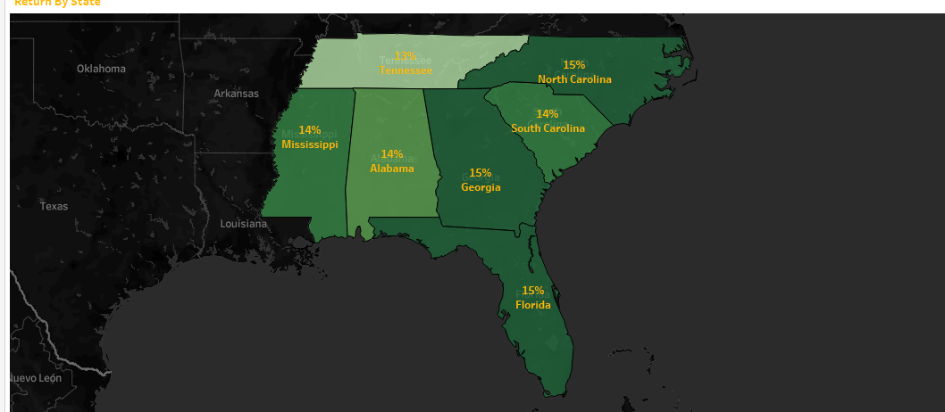
ANALYSIS OF THE DATA- Return By State
In 2018, Tennesse had the highest return rate while in 2019, Georgia had the highest return rate in 2019.

Slide 11
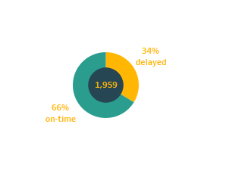
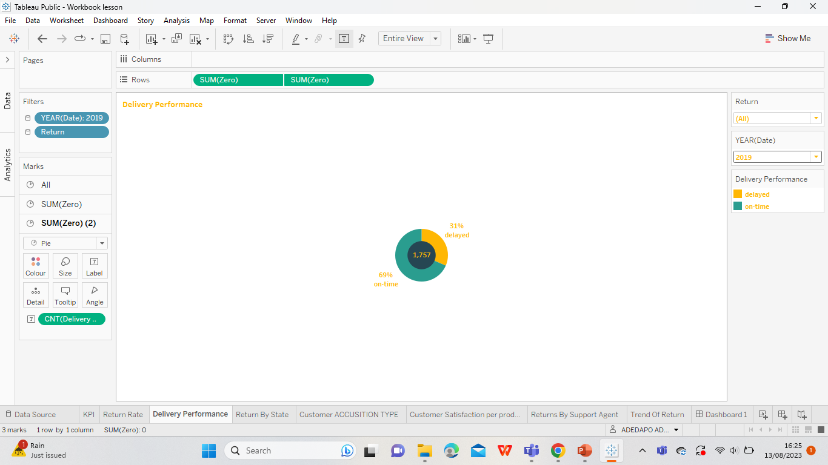
ANALYSIS OF THE DATA- Delivery Performance
There was an improvement in delivery performance over the time period 2018 to 2019 at a percentage of 66% to 69%. Goods and services was delivered on time. This is a positive step from this analysis as seen above

Slide 12
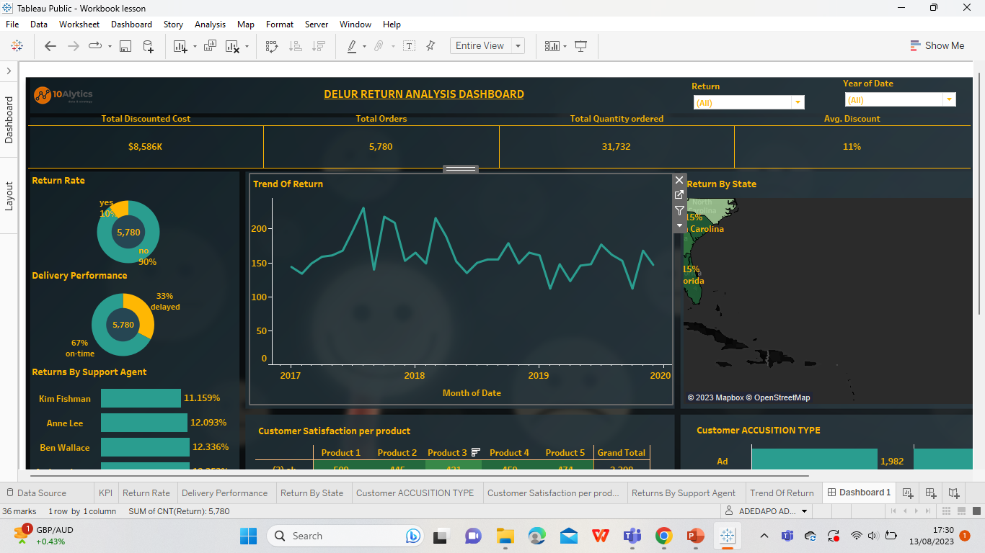
ANALYSIS OF THE DATA-Trend of return
We can see an up and down movement in trend of returns from January 2018 to December 2019.

Slide 13
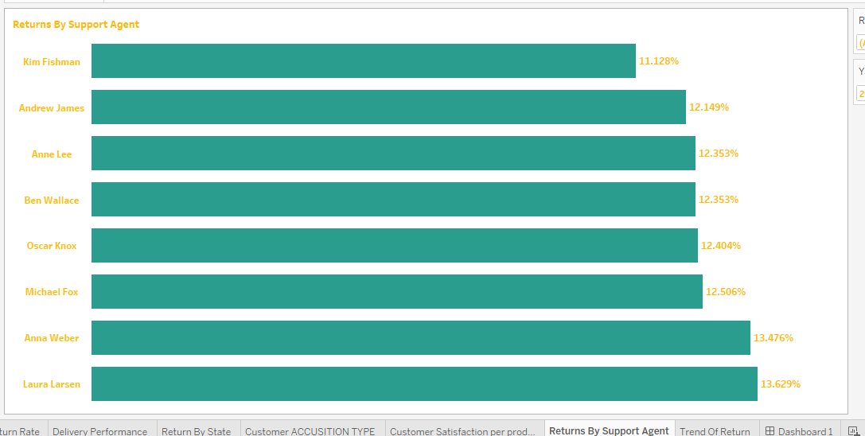
ANALYSIS OF THE DATA-Return By Support Agent
When we filter by returns, it is observed that Laura had a low return in 2018, but in 2019, she had a high return of about 14% from 9.7%. This shows something is wrong. We can check more agents and see how they are doing so we can know if we need to delve more into the data.

Slide 14


Recommendations
Use behavioral science to increase persuasion and drive momentum
Create collaboration plans that leads customers through the buying journey and prevent delays
New strategies and market campaign needs to be employed as customers that came through the Ad (Advertisement) channel returned more goods over the year 2018 and 2019.
There should be a reorientation of our customer support agent moving from 2018 to 2019.

Slide 15
Recommendations
We need to also inspect the quality of the product by introducing Quality control unit department of the company to checkmate the quality of the product
We need to implement customer incentives and what is ordered is what they get scheme in order to reduce customer dissatisfaction from reoccurring.
From the line chart showing the trend in return, to avoid an upward trend in returns. We need to foster good customer relationship with the customer support agent.

